Slide 1
Final Project Presentation
Mentor : Mrs. Santhoshi Kumari
Group No. : 18
Programme : B. Tech
Department : Computer Science & Engineering

Slide 2
Project Team
Sl no. | Registration no. | Students
1 | 17ETCS002227 | Shashi Kumar
2 | 17ETCS002040 | Ayush Prajapati
3 | 16ETCS002307 | Sandipan Chakraborty

Slide 3
Outline
Title and Aim
Objectives
Overviews
Methods and Methodology ( or Block Diagram)
Results
Cost Estimation
Work Load Allocation
Gantt Chart
Team Experience
References

Slide 4
Title: Decentralized Voting System
Aim:
To conduct a safe, secure, anonymous and fraud proof voting process without any manipulation.

Slide 5
Objectives
The objectives of the proposed Project are listed below:
To conduct a comprehensive literature survey on various methods for decentralized online voting systems.
To arrive at the design specifications of the system based on the identified requirements
To build a backend for interacting with an Ethereum Blockchain.
To build a Smart Contract to automate the execution of an agreement.
To design an Intuitive UI and develop a Web app based on the requirements.
To design a face recognition module to verify users for voting.
To document all the work as a report containing all the specifications.

Slide 6
Objective-1
To conduct a comprehensive literature survey on various methods for decentralized online voting systems.
Books and Published Papers will be studied to understand the work already done in the field of blockchain development.
Present voting process and their drawbacks will be studied.
Extensive survey was done to understand the tools required such as Ethereum Virtual Machine (Ganache), Remix IDE, PythonWeb3
Google Scholar

Slide 7
Objective-2
To arrive at the design specifications of the system based on the identified requirements.
The Functional Requirements will be derived.
Suitable UML Diagrams from Use-Case Diagram, Sequence Diagram will be drawn to represent the system specifications.
Follow an iterative development process, documentation attends less priority than software development

Slide 8
Objective-3
To build a backend for interacting with an Ethereum Blockchain.
A development blockchain Library / Software is used to create a local blockchain node
A backend API has been created to make a connection with the frontend UI
The API uses pre-built library to communicate with the blockchain

Slide 9
Objective-4
To build a Smart Contract to automate the execution of an agreement.
A different IDE used as a required Ethereum environment for writing contracts and deploy them into the blockchain.
Solidity programming language has been used to write contracts .
Remix IDE and Solidity for smart contracts.

Slide 10
Objective-5
To design an Intuitive UI and develop a Web app based on the requirements.
Design the UI/UX for web application
Implement the design using React.
Material.UI is used as UI/UX components

Slide 11
Objective-6
To design a face recognition module to verify users for voting.
A third-party library has been used to capture face geometry
Then created a 3D model with the stored values
Checked the same values at the time of voting for verification

Slide 12
Objective-7
To document all the work as a report containing all the specifications.
A project report will be authored documenting the entire development effort
All requirements will be documented in SRS format.
Design diagrams will be included in the report.
The working of the system will be documented including screenshots, figures, tables etc.
The user survey and its analysis will be documented.

Slide 13
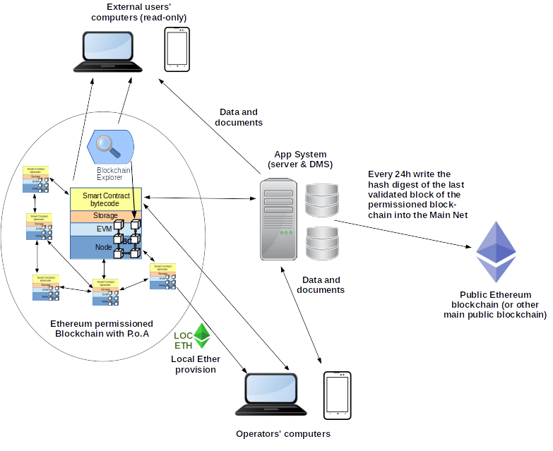
Overviews

Slide 14
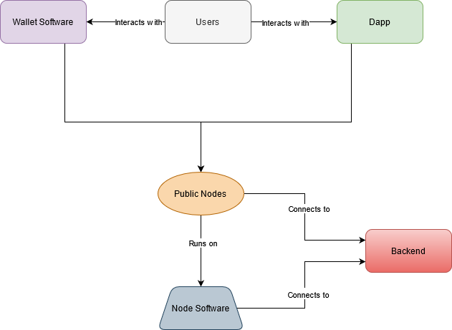
Block Diagram

Slide 15
Problem Solving
The development of the proposed system is carried out by following conventional practices of software development:
Requirement analysis
Implementation
Software UI design
Integration
Testing

Slide 16
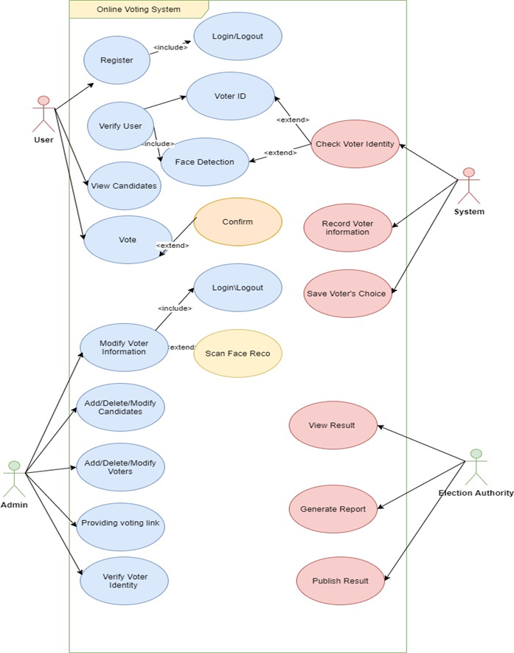
Design (Use case Diagram)
Notes:
We had done a lot of research and found that in online voting system the main challenge is security and the centralized nature which acts as a single source of truth and can be easily defrauded.

Slide 17
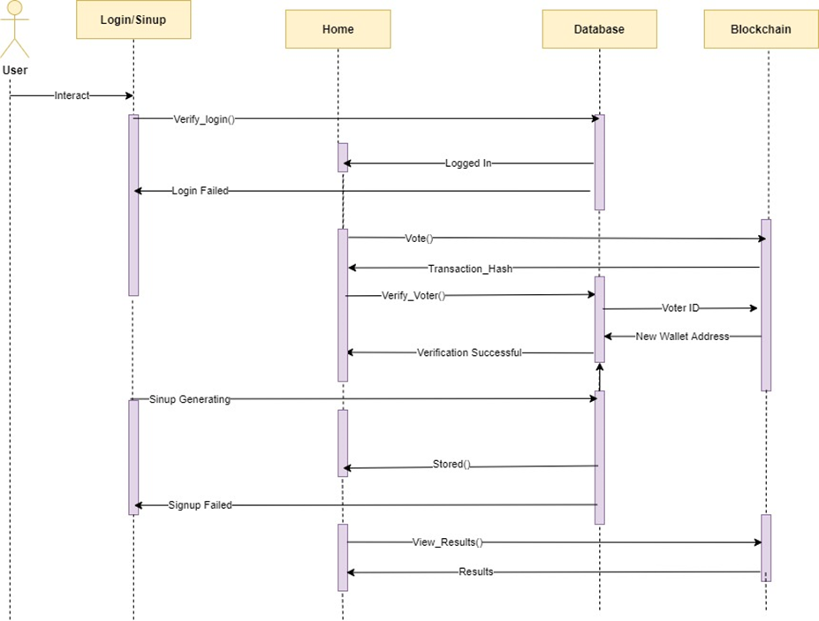
Design (Sequence Diagram)

Slide 18
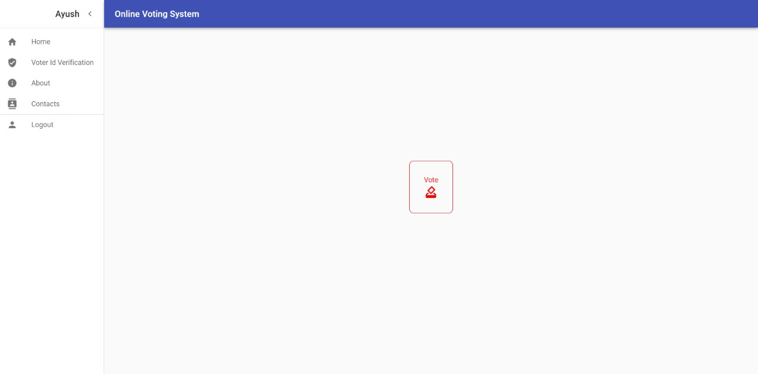
Results (Home page)

Slide 19
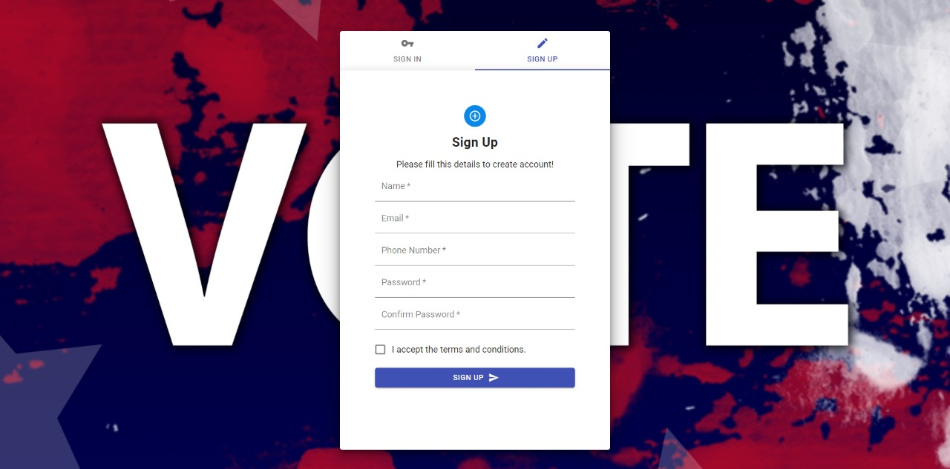
Results (Registration page)

Slide 20
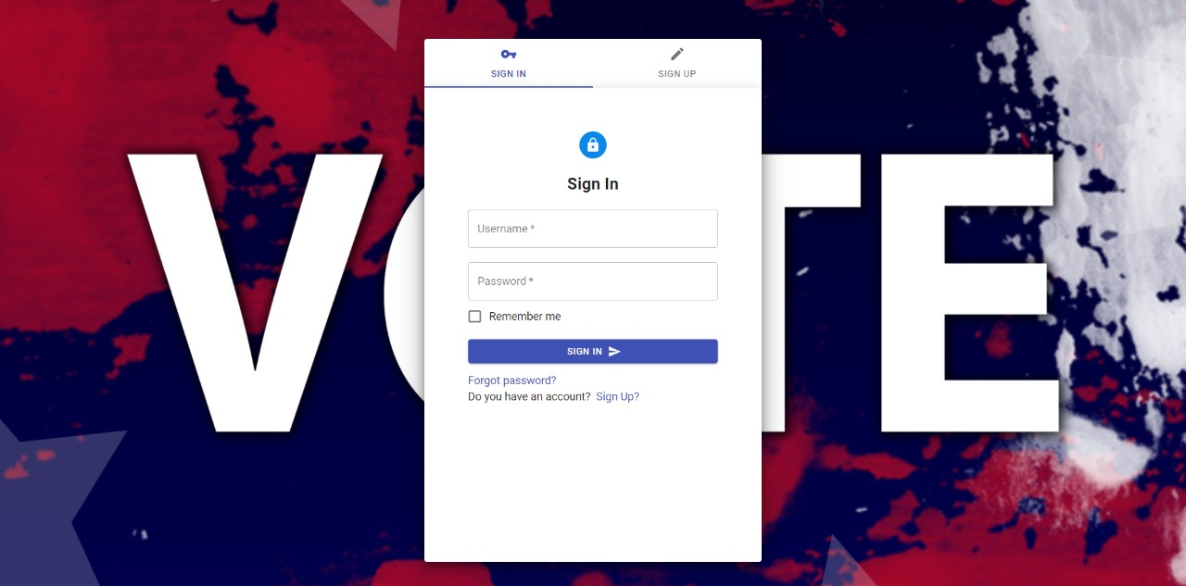
Results (Login page)

Slide 21
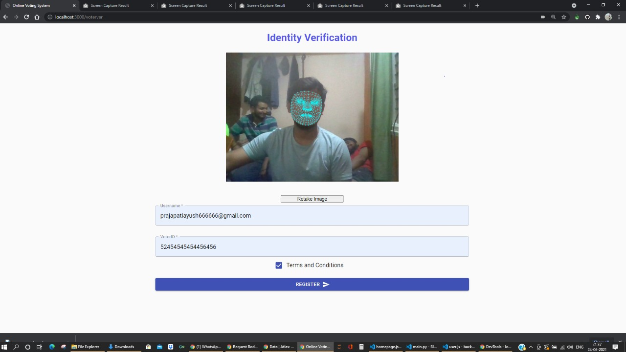
Results (verification page)

Slide 22
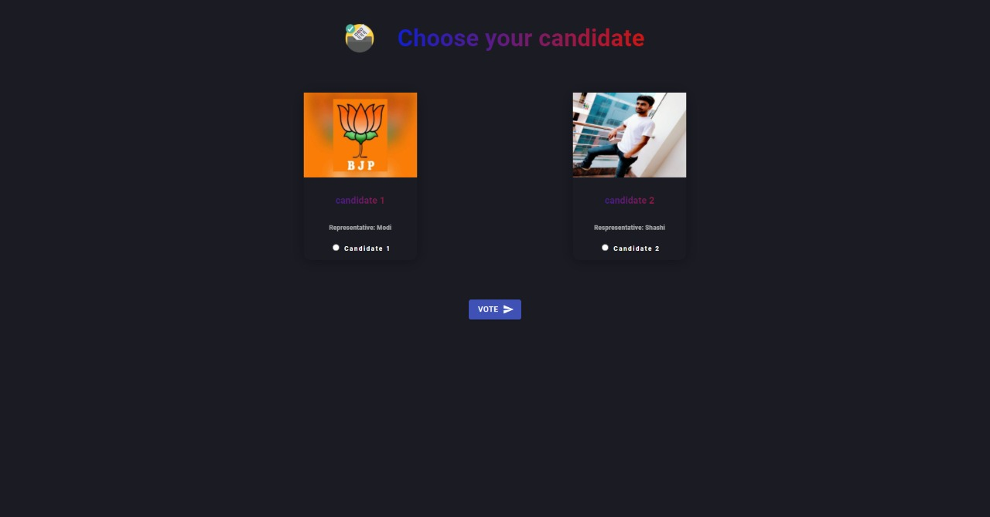
Results (Vote page)

Slide 23
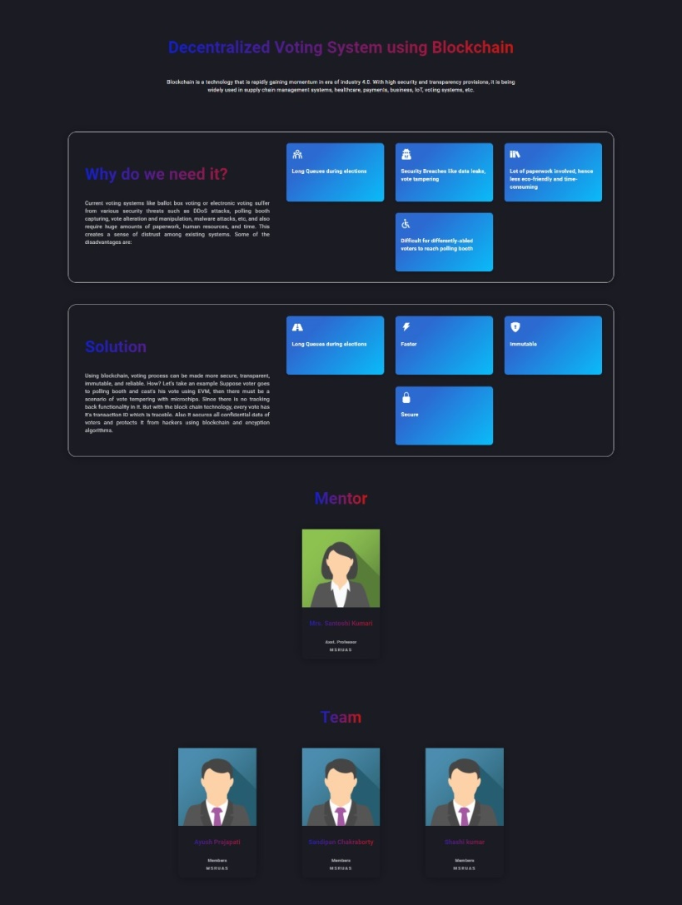
Results (About page)

Slide 24
Cost Estimation
Serial Number | Resources and Work | Cost(Rs)
1. Software: | Ethereum Virtual Machine, Solidity, Python, RestAPI, React.Js, MongoDB. | 1,45,000/-
2. GPU Training | 480 hours | 2,30,000/-
3. Internet Connectivity | 16 weeks X 3 Person | 1,60,000/-
4. Report | 1 person | 30000/-
Total Cost |  | 5,65,000/-
Man hours:
Man hours per week: 10 * 3 students = 30hours/week
Total number of weeks: 16
Total work done in this project: 16 * 30 = 480 hours

Slide 25
Work Load Allocation
 | Ayush Prajapati | Shashi Kumar | Sandipan Chakraborty
Literature survey
Documentation
Requirement analysis
Designing
Implementation
Deployment and Integration
Reporting

Slide 26
Gantt Chart
Project Work (UG) 16 weeks
Week | 1 | 2 | 3 | 4 | 5 | 6 | 7 | 8 | 9 | 10 | 11 | 12 | 13 | 14 | 15 | 16
Major Activities
Literature Survey
UML Design
Frontend Developing
Backend Developing
Blockchain Development
Model Testing & Evaluation
Integration and Testing
Report Generation

Slide 27
Team Experience
Working as a team together helped each member of the team to learn about the technologies and the theories involved on the topics of Blockchain, MongoDB, REST APIs, software development architecture, system deployment, Decentralized application development, cutting edge frameworks and UI/UX designing philosophies.
Workload management and synchronization was difficult at times, which are the characteristics of any team undertaking tasks of such proportions.
The overall growth in the team surpasses any individual effort and the experience is quiet rewarding.

Slide 28
References
Springall, D., Finkenauer, T., Durumeric, Z., Kitcat, J., Hursti, H., MacAlpine, M. and Halderman, J.A., 2014, November. Security analysis of the Estonian internet voting system. In Proceedings of the 2014 ACM SIGSAC Conference on Computer and Communications Security (pp. 703-715).
Govindaraj, R. and Kumaresan, P., 2020, February. Online Voting System using Cloud. In 2020 International Conference on Emerging Trends in Information Technology and Engineering (ic-ETITE) (pp. 1-4). IEEE.
Patil, H.V., Rathi, K.G. and Tribhuwan, M.V., 2018. A study on decentralized e-voting system using blockchain technology. Int. Res. J. Eng. Technol, 5(11), pp.48-53.
YI, O.K. and DAS, D., 2019. Block Chain Technology For Electronic Voting. Journal of Critical Reviews, 7(3), p.2020.
Buterin, V., 2016. What Are Smart Contracts? A Beginner’s Guide to Smart Contracts.
Ooi, E., 2020. A secure, anonymous and verifiable E-Voting system (Doctoral dissertation, UTAR).

Slide 29
References (Contd.)
Hjálmarsson, F.Þ., Hreiðarsson, G.K., Hamdaqa, M. and Hjálmtýsson, G., 2018, July. Blockchain-based e-voting system. In 2018 IEEE 11th International Conference on Cloud Computing (CLOUD) (pp. 983-986). IEEE.
Gupta, S. and CR, M., 2021. Blockchain-based Preferential E-Voting System DApp using Smart Contract. Available at SSRN 3835096.
Kim, C.J., 2018. An online voting system based on Ethereum block-chain for enhancing reliability. Journal of the Korea Academia-Industrial Cooperation Society, 19(4), pp.563-570.
Marr, B., 2018. A very brief history of blockchain technology everyone should read. Forbes, February, 16.
YI, O.K. and DAS, D., 2019. Block Chain Technology For Electronic Voting. Journal of Critical Reviews, 7(3), p.2020.
Suryavanshi, A., 2020. Online Voting system. Available at SSRN 3589075.

Slide 30


